Slide 1
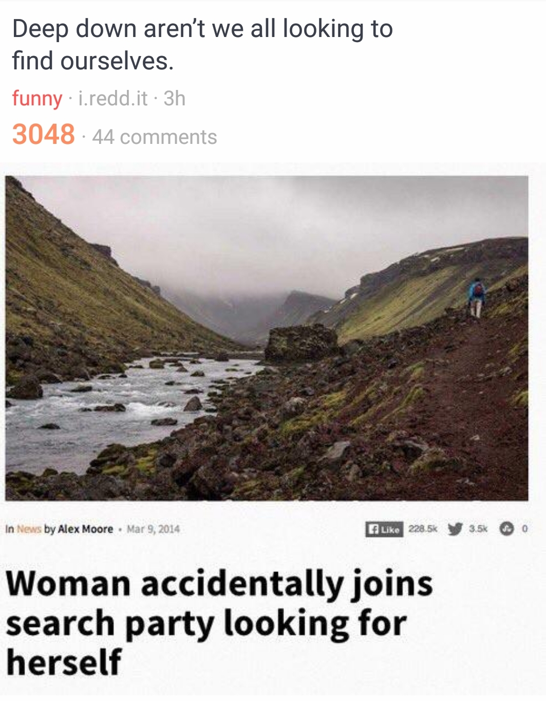
@smileandeliver

Slide 2
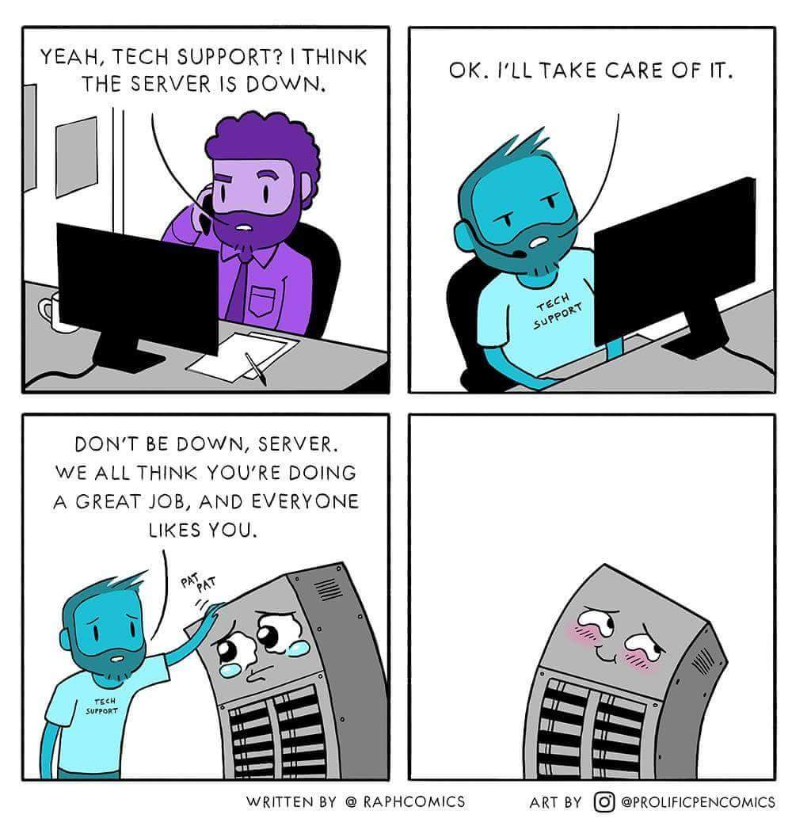
@smileandeliver

Slide 3
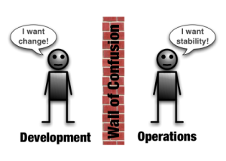
@smileandeliver
Notes:
Culture and Incentives are at odds with each other

Slide 4
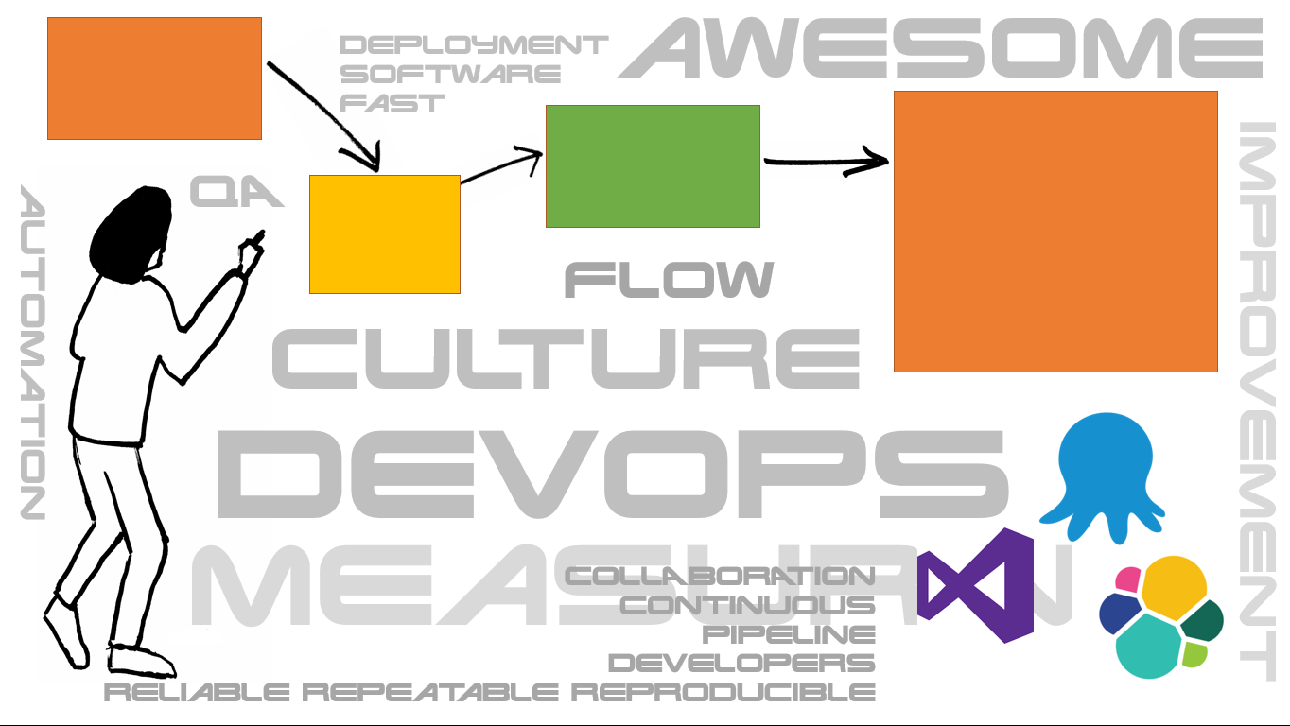
C
A
L
M
S
CULTURE
@smileandeliver

Slide 5

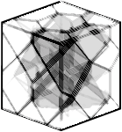
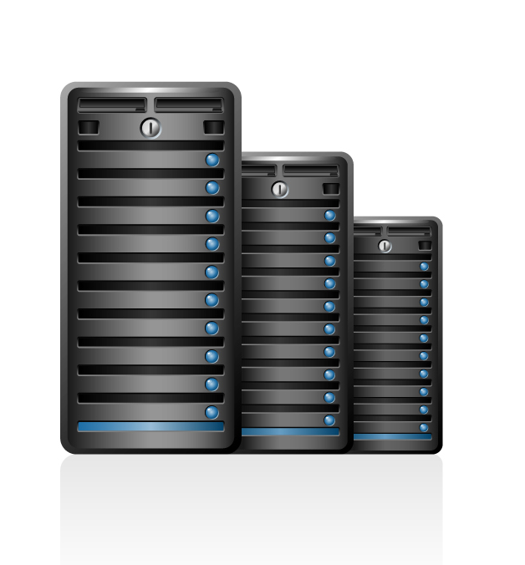

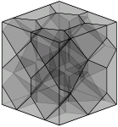
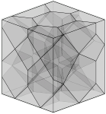
C
A
L
M
S
AUTOMATION
@smileandeliver

Slide 6
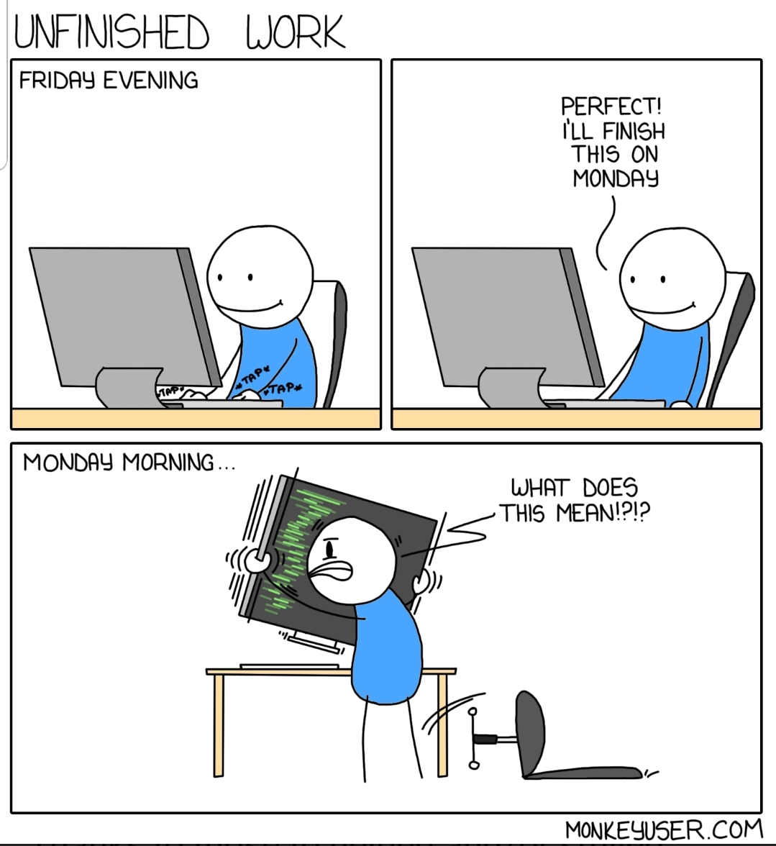
C
A
L
M
S
LEAN

Slide 7

C
A
L
M
S
MONITORING

Slide 8
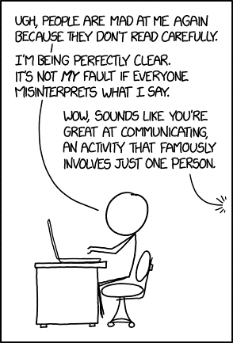
C
A
L
M
S
SHARING

Slide 9

“Testing Is DevOps”
@smileandeliver

Slide 10


Dev
Ops
Dev
Ops
Dev
Ops
@smileandeliver

Slide 11

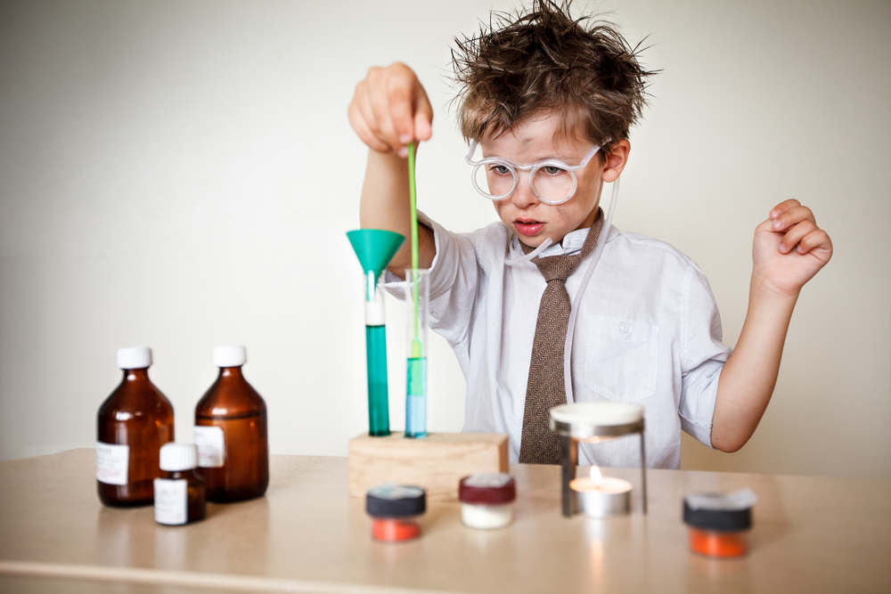

Three Ways of DevOps
God
Reporter
Genius
@smileandeliver

Slide 12

Gods
The First Way
Systems Thinking
The Second Way
Reporters
Amplify Feedback Loops
The Third Way
Geniuses
Culture of continual experimentation and learning
@smileandeliver
Notes:
[This slide is animated ‘on click’ for the words Gods, Reporters, Geniuses to appear]
Time to split up into your three groups – Think about the ‘way’ that you have chosen; what ideas do you have – or what changes could you make in your organisation which will facilitate and promote your way.
In DevOps, you need all three of these for success! But right now, just go with yours
I will leave a video loop playing so that you can get a reminder of each ‘way’ and what it means, if you need it. Don’t be too tied down by these definitions – just write down any ideas for improvement as they occur to you.
(Direct participants to their flipcharts or whiteboards)
You have x minutes – please feel free to ask anything as you go

Slide 13
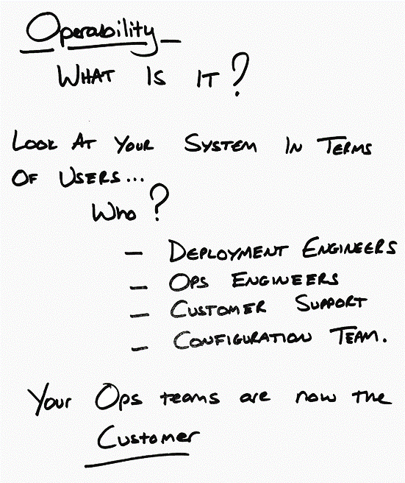
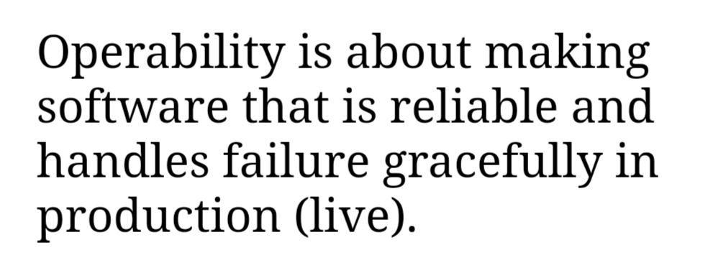
@smileandeliver

Slide 14
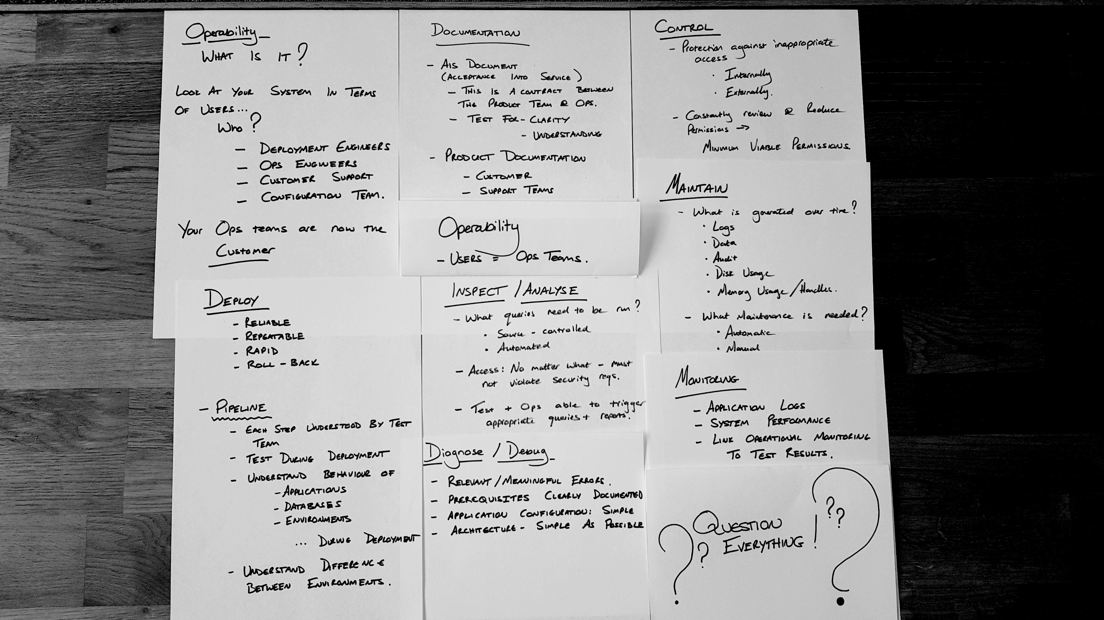

Slide 15

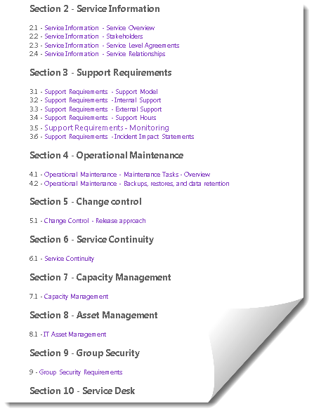
Operability Documentation
AIS DOCUMENT
(Acceptance into Service)
Operability Contract between All teams
Clarity
Understanding
Completeness
PRODUCT DOCUMENTATION
Customer Facing
Support
Architecture
Notes:
· Recovery Time Objective (RTO)
· Recovery Point Objective (RPO)
· Minimum Recovery Operating Level (MROL)

Slide 16
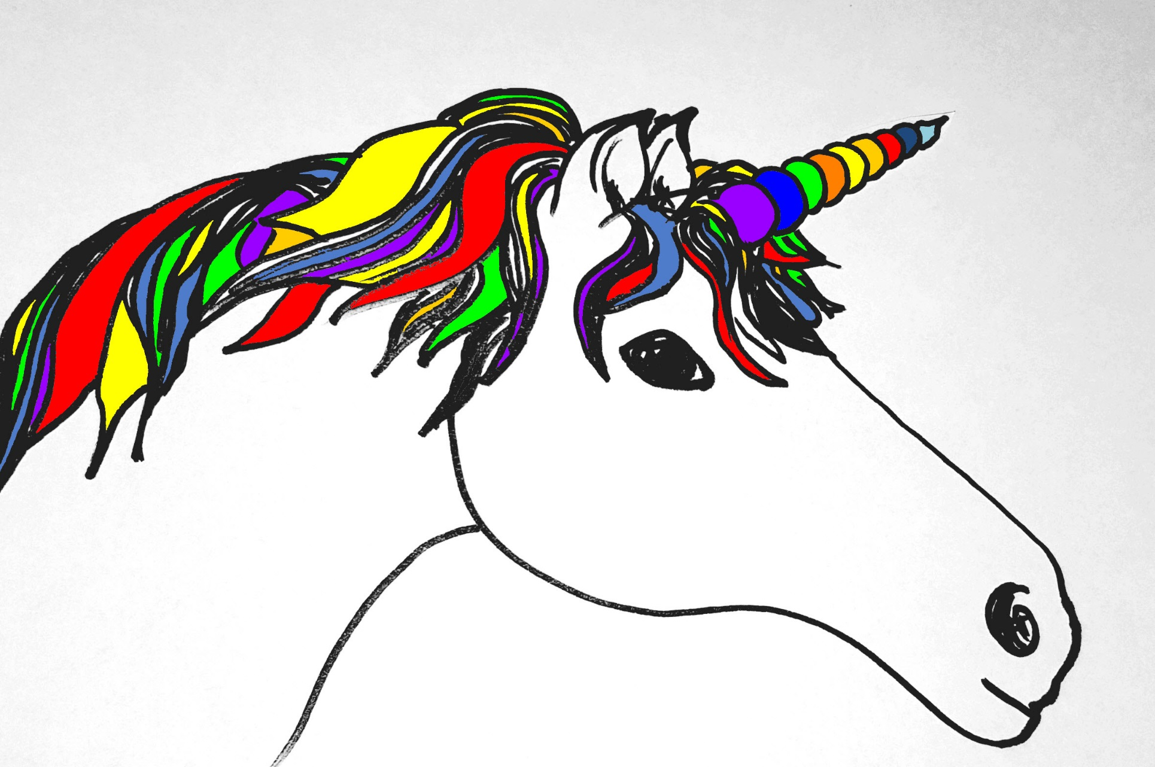

Deployability
Reliable
Repeatable
Rapid
Roll-back
PIPELINES
Each step understood
Applications / Services
Databases
Environments
Walking Skeleton
Test During Deployment

Slide 17

Maintainability
What builds up over time?
Logs
Data
Audit
Memory Usage
What Maintenance is Needed?
Automatic
Manual
@smileandeliver

Slide 18
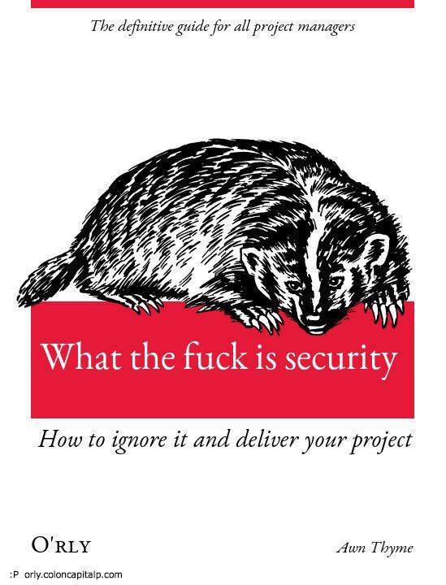
Control
Protection against inappropriate access
Internally
Externally
Regularly Review and Reduce Permissions
Minimum Viable Permissions
Access via Controlled System
Access Audit

Slide 19

Monitoring
Application Logs
System Performance
Link Ops Monitoring to Test Results
Inspect/Analyse
What queries need to be run?
Source-Controlled
Automated
Access: Must comply with Security Reqs
Test & Ops Teams able to trigger Appropriate Queries & Reports
Diagnose/Debug
Relevant / Meaningful Errors
Prerequisites Clearly Documented
Simple:
Application Configuration
Architecture
@smileandeliver

Slide 20
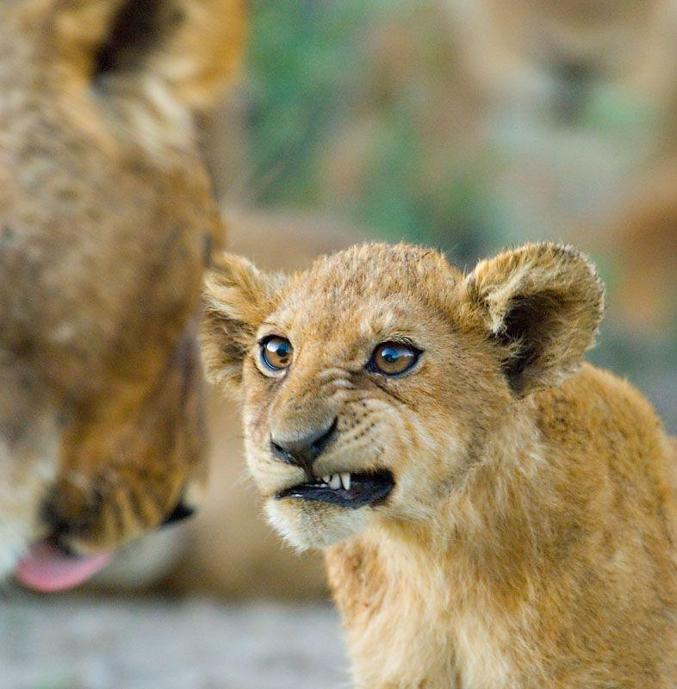
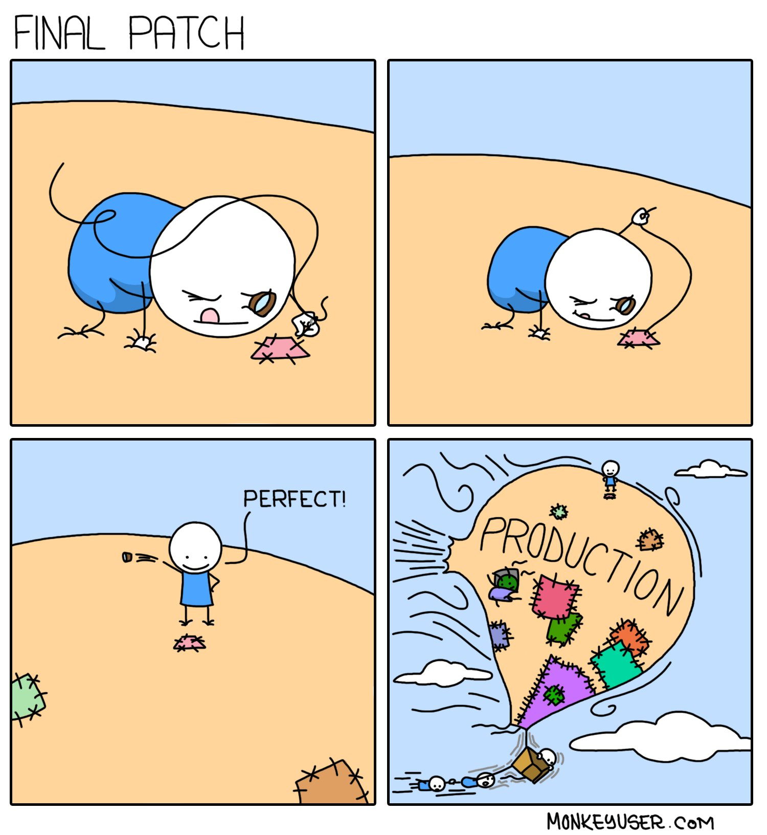
@smileandeliver

Slide 21
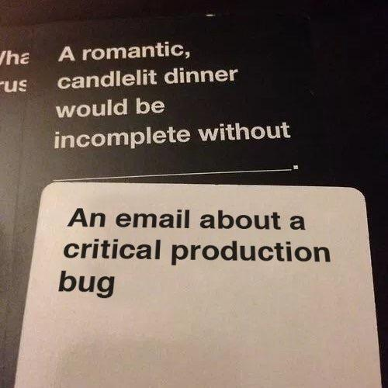
@smileandeliver

Slide 22
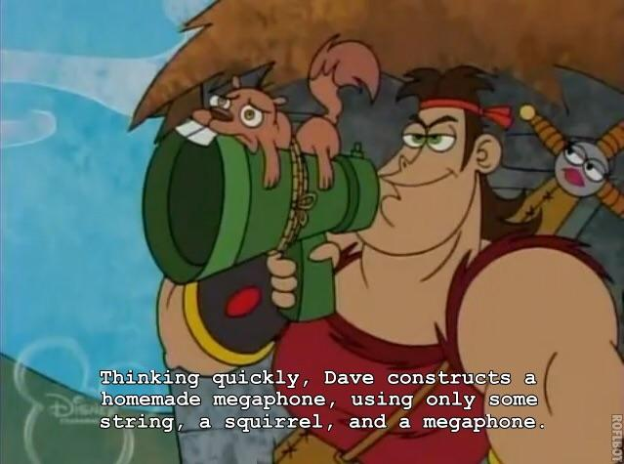
Complexity:
One of the greatest enemies of Operability
@smileandeliver
Notes:
Have we delivered the Requirements in the most efficient way?

Slide 23
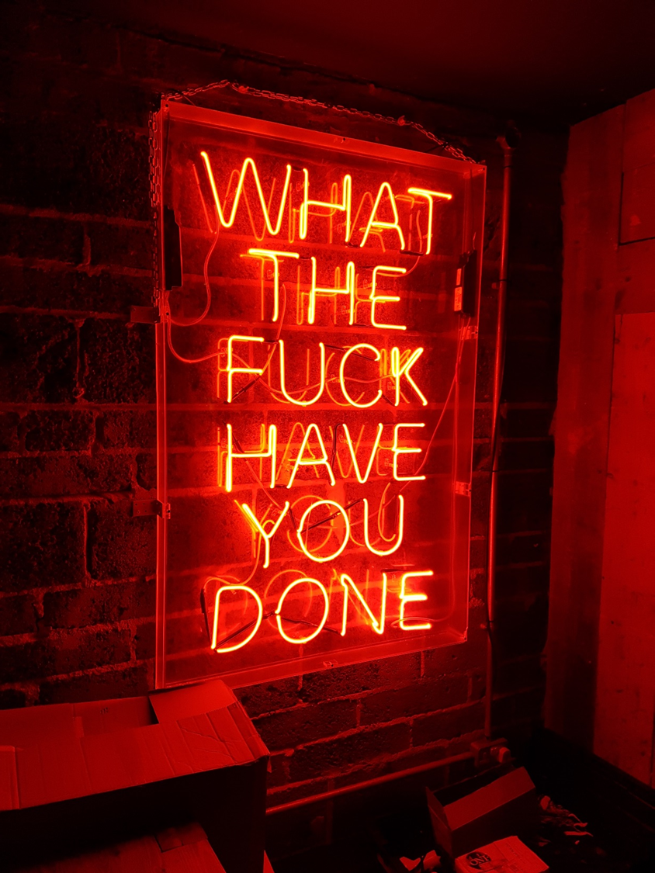
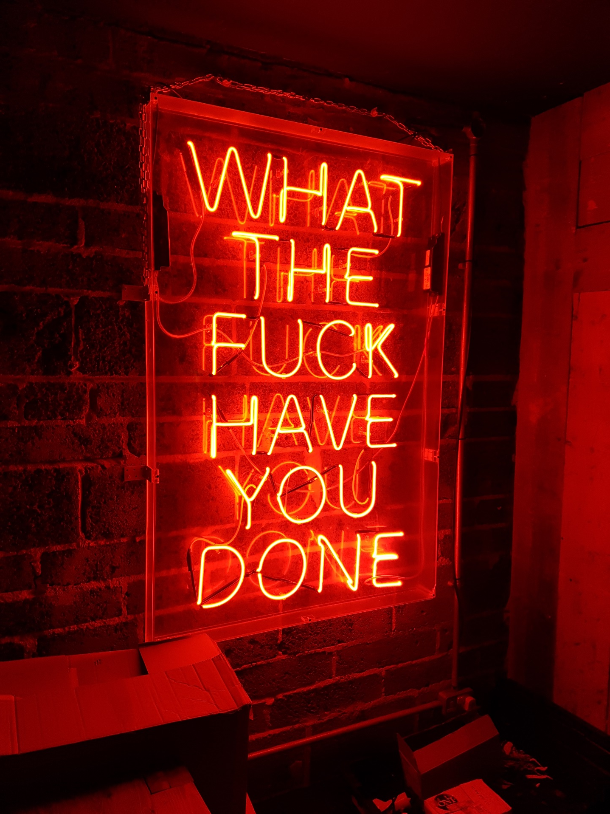
@smileandeliver
Notes:
Permissions

Slide 24

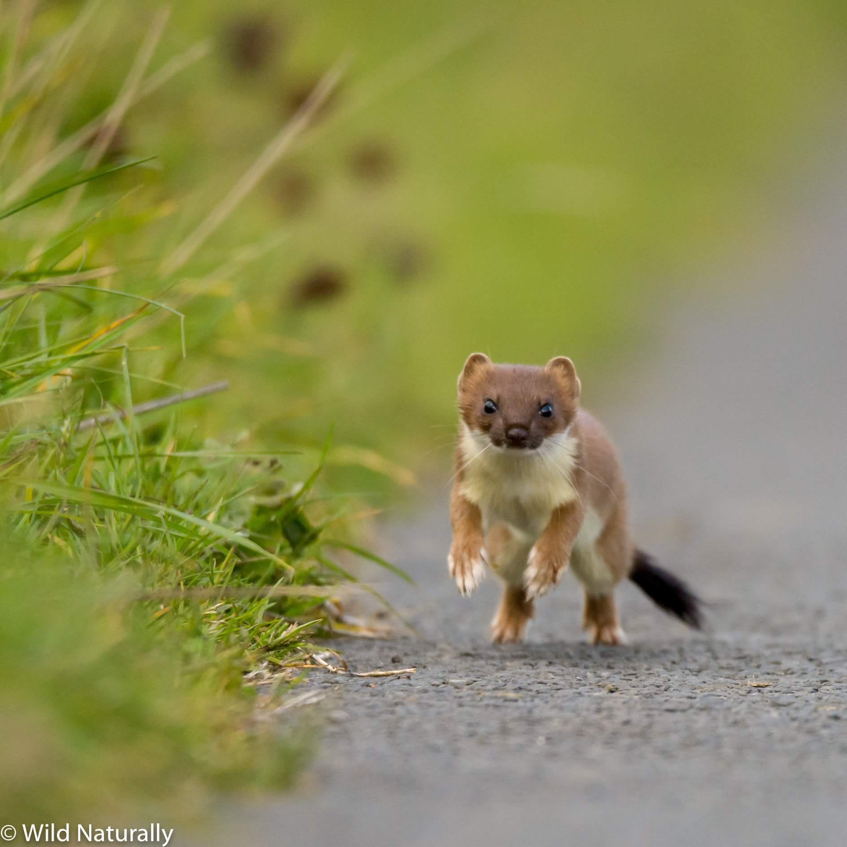
@smileandeliver

Slide 25
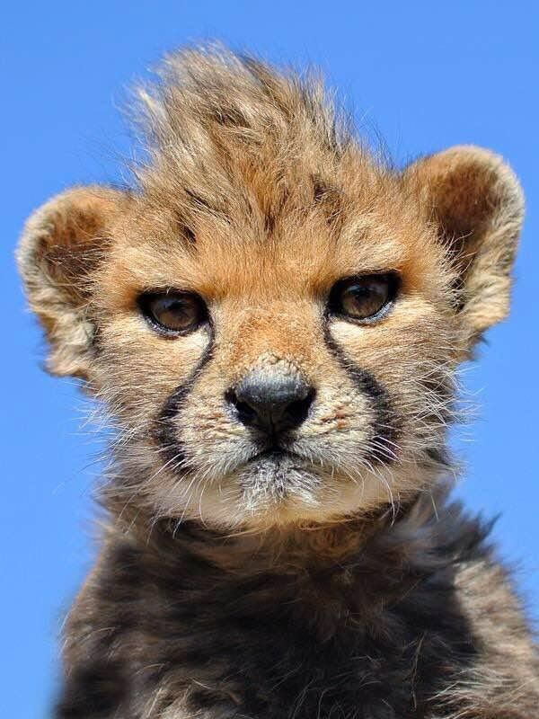
@smileandeliver

Slide 26
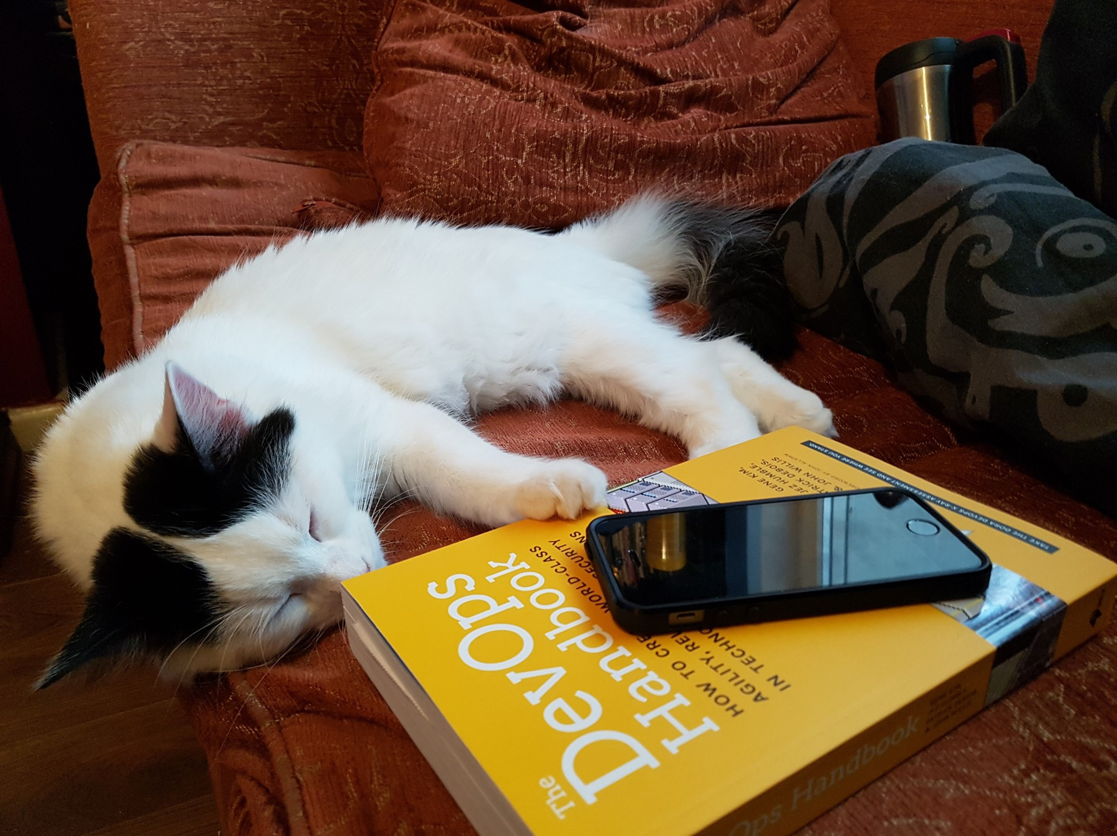
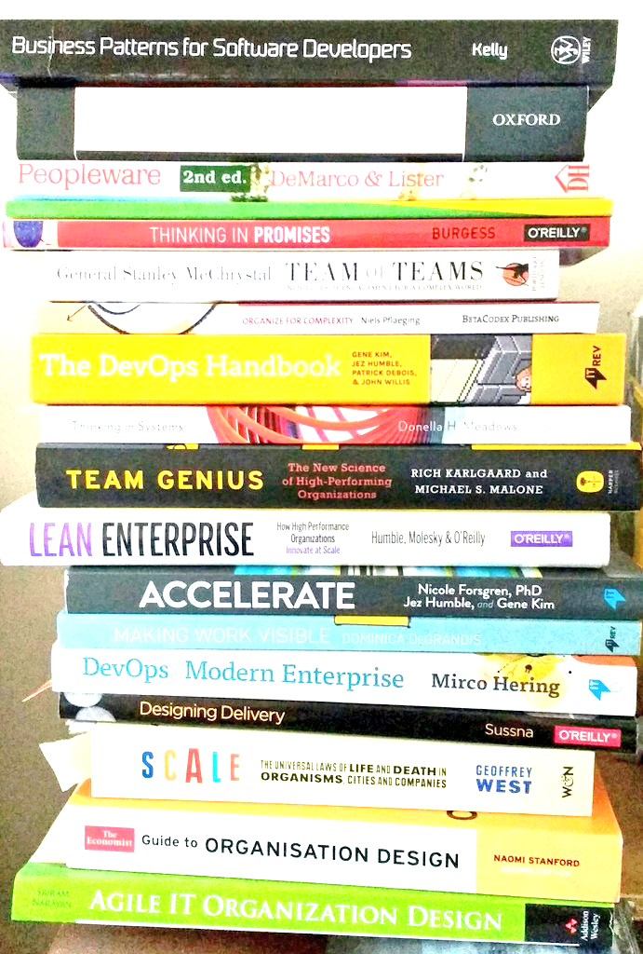
@smileandeliver
Notes:
Insert credits here particularly Continuous Delivery, DevOps Handbook, Phoenix Project and Software Operability Manuel Pais and Matthew Skelton

Slide 27

Header
@smileandeliver
https://github.com/smileandeliver/
Notes:
Thank you and please come forward with any questions

Slide 28


Slide 29
